Slide 1
Advising in Distance Education at Unity College

Slide 2
What makes Advising in DE different?
Highly collaborative
One stop shop model
High touch support
Notes:
Professional advising – this is the sole focus of the advising staff, not a part-time function of another position
This is a specialized function

Slide 3
Director of Enrollment Management
Team Structure
Associate Dean of Retention and Completion
Undergraduate Advisor
Graduate Advisor
Undergraduate Advisor
Undergraduate Advisor
Notes:
Advising is normally an academic function, not a function of enrollment – that’s a major difference for us, and very intentional. We’ll explain why later.
Heuristics tell us when more staff are needed – workload is 250 students, and we hire more staff when approaching 190

Slide 4
Advising is Relationships
Concierges
Students
Faculty
Academic Deans
Instructional Designers
Registrar
Student Financial Services
Notes:
Relationships cover a broad spectrum of units, and many levels of engagement
Operations, Career Services, IR, Marketing and others are critical to our success as well, but we only have so much time today! I’d be happy to talk more about those other relationships at another time, because they’re incredibly important to us as well.

Slide 5
Collaboration
Notes:
Back to what makes DE Advising different – our level of collaboration with other units.
As professional advisors, we need solid working relationships and open lines of communication to be effective.

Slide 6
Concierges
Concierges are the primary contact for incoming students through the add/drop period of their first term
Concierges complete Orientation calls, enroll them in their first course, help them understand financial aid and make their first payment
--------------------- ADD / DROP ---------------------
Student officially begins with their Advisor after Add/Drop, and stays with the same Advisor for the rest of their academic career
Warm hand offs are critical
Unique scenarios and outstanding student needs
Consistency is critical so students have the same expectations, experience and information when transitioning
Notes:
After the add/drop period, the student is officially working with their advisor for the rest of their time at Unity.
The Associate Dean is responsible for assigning students to an advisor and managing their student load, and reviews enrollment projections to plan workloads
Warm handoffs are critical to keep students working with the right person – either starting with an advisor early because they’re excited, or going back to their concierge because they have such a good connection.
Unique scenarios such as accommodations, payment arrangements, custom scheduling needs due to finance limitations
Outstanding student needs happen as we approach a term start – students want to begin at the last minute and are missing low-risk items that won’t prevent them from starting (Master Promissory Note, Loan Entrance Counseling). Concierges and Advisors collaborate and work out agreements for these students to begin.

Slide 7
Faculty
Both have the ability to create system alerts, providing critical information for student interaction and intervention
Faculty will often reach out to advisors with student concerns, and vice-versa
Take a team approach to communication (more is more)
Clear lines of responsibility are in place: Student requests often overstep with Advisors – seeking grade changes, extensions, etc. Important that advisors reiterate anything course, assignment, grade related needs to be directed to their faculty member
Advisors may facilitate communication between faculty and student
Accommodations are addressed by the Associate Dean and directly communicated with Faculty
Shared goal of student success
Notes:
Advising isn’t nested within academics, which is unique, but they work towards a shared purpose
Both want students to succeed, and with two advocates the student is better equipped to thrive

Slide 8
Academic Deans
Have a close working relationship with the Advising team to meet student needs
Work closely with advising team on course roll out plans
Approve course waivers/substitutions as necessary
Field escalated student concerns about faculty
Faculty and advisors may be involved in concerns about plagiarism, student conduct, etc. Academic Deans will be involved as necessary.
Academic Deans are a primary resource for faculty, but student issues often will involve Advisors as well.
When it comes to the student experience, there are no barriers between the Academic and Enrollment teams
Notes:
chain of command for escalation: student to faculty, if still unresolved, student to advisor, advisor to Associate Dean, Associate Dean to Academic Dean).

Slide 9
Instructional Designers
The ID team is responsible for all content in Canvas
Coordinate the opening of course sections for a new term (in particular, EVPC 101 pre-course module).
Technical feedback about a course (broken links, etc.) will be referred to the ID team who troubleshoots and fixes.
Design feedback, both positive and negative, is shared when available
Coordination with IDs allows us to continually improve the course experience for students
Notes:
Course feedback is often gathered through surveys, filtered through faculty or put into a database for review (at some time).
Interviewee for a LARGE online program discussed their feedback loop: if a broken link existed or someone had a concern, it was entered into a database. When asked what happened to it from there, he said “we hoped it would be fixed, but we never knew. We couldn’t see the courses, and no one ever told us what happened – we’d only know if someone kept complaining about it”

Slide 10
Registrar
Transfer Evaluation is a critical component of student engagement
Official evaluations inform how Advisors register students and set up academic plans
Assistant Registrar troubleshoots special case student circumstances, concerns related to registration and grading, as well as keeps track of important information related to military benefits (VA).
Produces enrollment verifications, prior approval transfer forms, other assorted official paperwork for DE students.
Registrar collaboration ensures students receive the credits they expect, and allows us to provide a clear picture of the future.
Notes:
Almost all students are providing transcripts for evaluation, many students with multiple
The unofficial evaluation completed by Operations is critical for Concierges, and Official Evaluation completed by the registrar influences the student’s academic plan
Lack of clarity about “When will I finish” is a major concern of students, and in many cases is why they’ve left another institution.

Slide 11
Student Financial Services
Continuous coordination with SFS on student concerns related to Financial Aid packaging, documents, scholarships, payment & billing.
Our unique financial aid model requires extensive communication and explanation with students should they fail or withdraw from a course.
Assist with set up payment plans and unique payment arrangements
Shared data and thorough training allows us to speak with confidence about complex situations
95% / 5% rule
A team approach and open communication provides students with relief – finances are major concern and need to be handled delicately
Notes:
95/5 – Advisors are in a place to handle a majority of questions related to financial aid. The 5% of extremely unique scenarios SFS is happy to assist, provide feedback and explain through the situation. There are no silos, no “locked away” data or refusal to share information.

Slide 12
One-Stop Shop
Notes:
We’ve talked about our collaboration within Unity, but not our interaction with students.
This is where we set ourselves apart, and how we are able to retain at such high levels.
Professional advising with a one-stop shop, meeting student needs head-on.

Slide 13
Students
The most important relationship for Advising!
How we measure success: retention and completion
Role of the Associate Dean is to ensure that the design of student services allows advisors to work effectively in support of their students’ success.
Students will work with the same Advisor for the duration of their time at Unity.
The advisor will be their primary point of contact for ANY issue that arises.
We may not have the answer or be able to resolve immediately – but are always the first line of support and will facilitate help from other areas.
Notes:
Questions about bills, Financial Aid, Transfer Credits, Assignments, Accommodations, Books, the Library… absolutely anything.
Sometimes it’s just to talk – problems with time management or a fellow student, and just want to vent.
If we don’t have the answer, we will get it – and set a clear timeframe for follow-up.

Slide 14
Broad scope of communication
1 week prior to term start:
Welcome email to NEW students, introducing the advisor, directing students to Pre-course Module in Canvas, reminder of next steps.
1 week prior to term start:
Reminder email to RETURNING students, reminding them again of the term start, to check for required materials, make payments if necessary.
Every Monday:
Highlight important resources and information, such as TutorMe, TAO, withdrawal deadline, transfer evaluation information, future registration and schedule information, how to access student course evaluations, where to find required course materials.
Notes:
Establishes continuous and consistent open channel of communication between students and advisors
Covers resources utilized by different units, all with a shared purpose – student success
These are the broad communications that all students receive, and doesn’t account for the personal outreach also taking place

Slide 15
High touch support
Notes:
We know that our students are working adults with high financial need and most are transferring in credit from other universities.
This means they often have had prior experiences in higher education and sometimes will come to us with pre-conceived notions about how things were done somewhere else.
They left other colleges (or never started) for a reason – we want to give them every reason to continue and be successful, and we do not do things like other places.
They will not get lost or be just a number – we have technology in place to prevent it.
Some students appreciate the high-touch model, some do not – those that don’t will not engage with us and tend to be successful independently… but they don’t have a choice. We’re consistent.

Slide 16
What is High Touch Support?
In addition to weekly emails, advisors communicate with students extensively via email, phone, text and Canvas.
Advisors are expected to:
Be familiar with courses and assignments
Check on student progress week over week
Communicate with students if they miss assignments or if their grades are of concern
Track participation for six day (UG) or eight day (grad) attendance policy
Process withdraws (by student request or administrative) and stop outs
Register students for all of their courses
Maintain the student’s academic plan
Utilize a variety of systems to track progress and maintain student records
Manage start/end of term transitions
Notes:
The depth of knowledge is extensive – courses, assignments, program requirements, all across the entire catalog
some students prefer more control, but we’ve found they over-estimate their capacity.

Slide 17
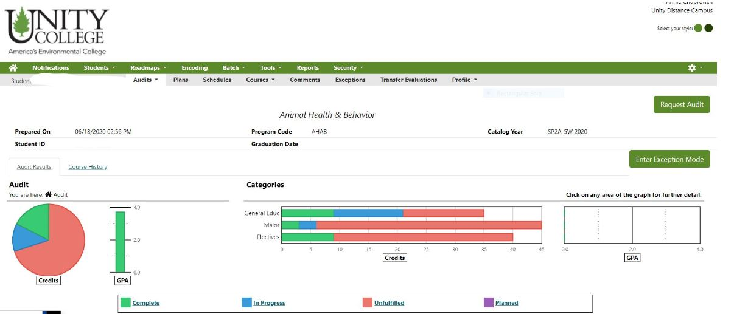
uAchieve
Place your screenshot here
Course planning, registration, academic plans, and degree audits.

Slide 18
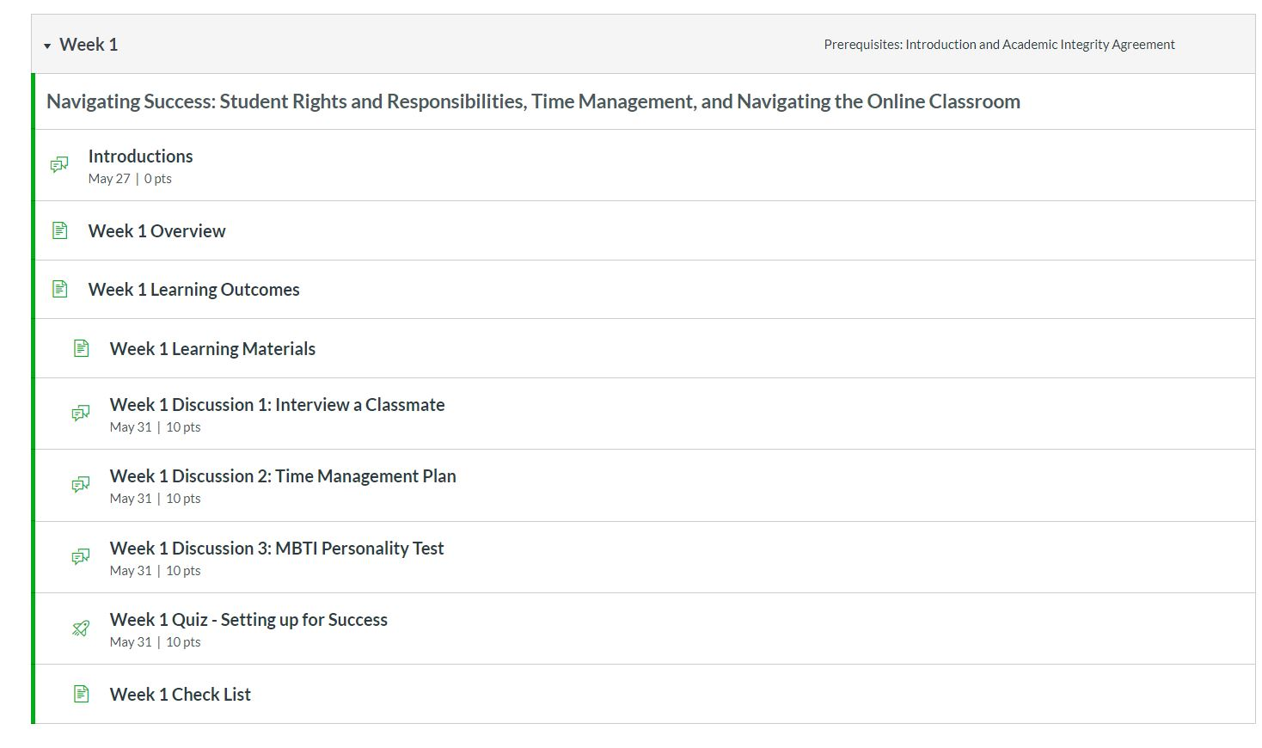
Canvas
module view
Review of course layout and assignments

Slide 19
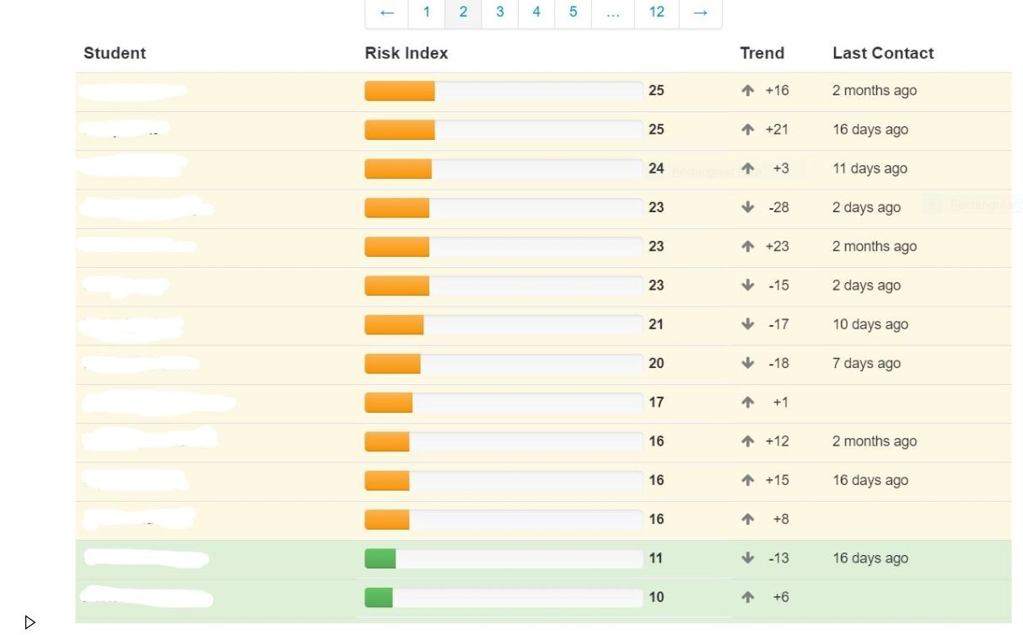
Dropout Detective
module view
Primary tool for student trends, risk identification and student intervention

Slide 20
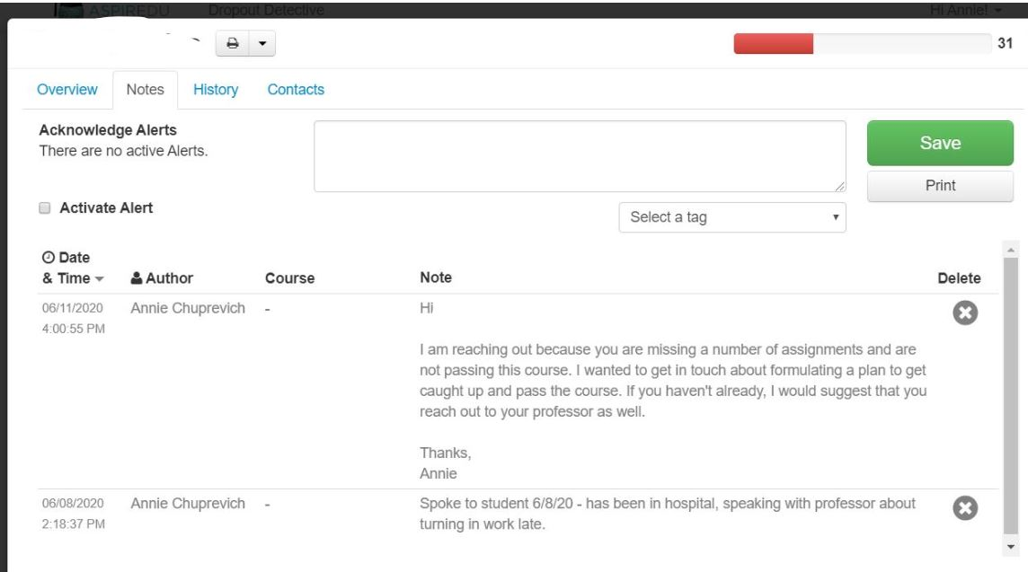
Dropout Detective
Notes
Provides consistent tracking of student history

Slide 21
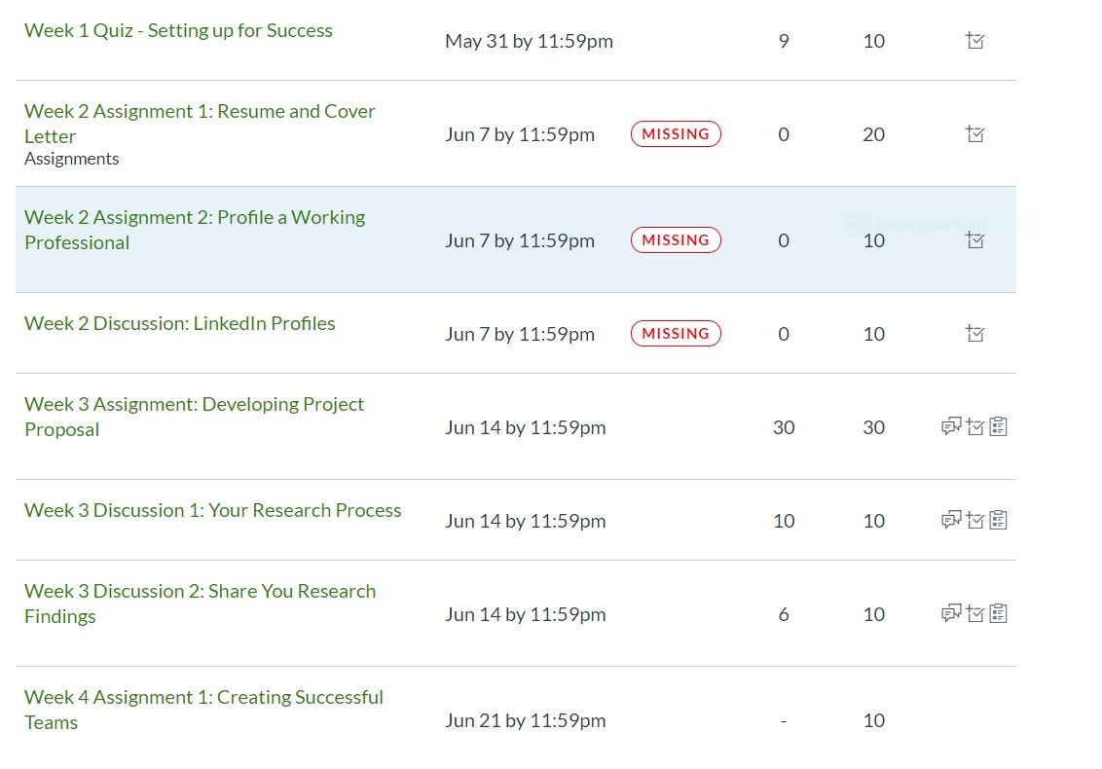
Assignments
Detail of specific assignments, grades and status

Slide 22
Communication is consistent throughout the term, but the end of a term (and quick start to another) creates a peak workload for all advisors:
Check all student grades.
Determine if student needs to retake course.
Change future registration as necessary.
Monitor GPA for SAP.
Explain financial aid implications if student failed or withdrew.
Make sure any incompletes have been appropriately processed.
Week prior to term start, initiate contact, with new and/or returning email.
Reach out to stop outs to see if they are ready to return.
For any returning students, advisors are responsible for payment arrangements/participation during add drop.
Term Transitions
Notes:
The depth of knowledge is extensive – courses, assignments, program requirements, all across the entire catalog
some students prefer more control, but we’ve found they over-estimate their capacity.

Slide 23
Recruitment
Advisors are responsible for re-recruiting their students every term
Notes:
New terms start every 5 (or 8) weeks – there’s no guarantee that our students return.

Slide 24
Advising is Relationships
Concierges
Students
Faculty
Academic Deans
Instructional Designers
Registrar
Student Financial Services
Notes:
Relationships shape our work and influence the student experience.
Collaboration across academic, recruitment and support teams is unique and drives our success.

Slide 25
Thanks!!
Any questions?

