Slide 1
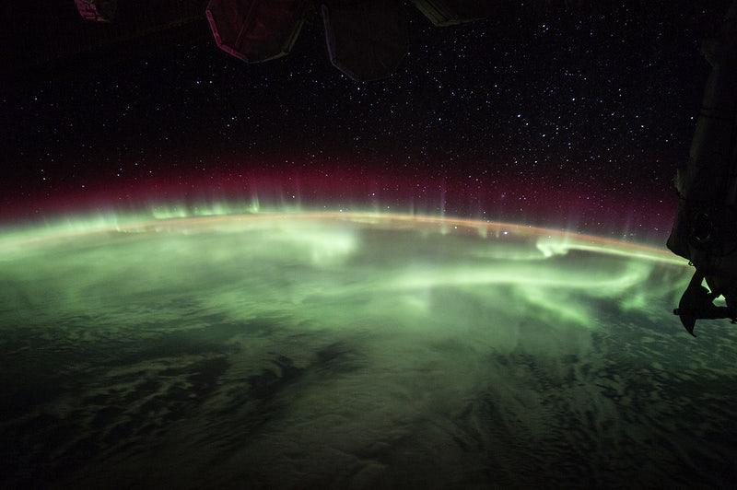
The Role of Instructional Design
Unity College Distance Education

Slide 2
Hello!
My Name is...
Chris Malmberg
You can find me at: cmalmberg@unity.edu

Slide 3
Course Design Process
Canvas
Master
DEAN
Course Purpose / Vision
DEAN
Milestone 1
DEAN
Milestone 2
ID / SME
Final Project Ideation
ID / SME
Final Project Draft
ID / SME
1st Complete Course Draft
ID / SME
Final Course Draft
16 Weeks

Slide 4
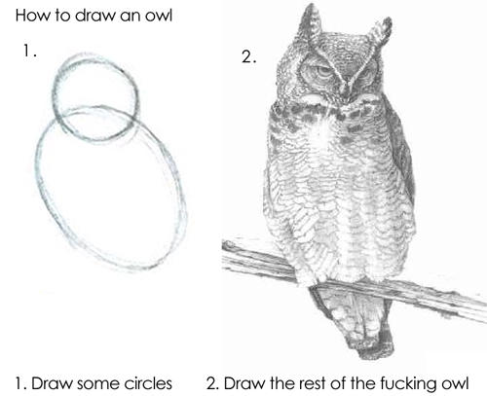
Instructing others is hard...
censored

Slide 5
...and understanding what we want to ask of our students is even harder.
Successful students will:
Draw
an owl.
Successful students will:
Depict
an owl’s
physiognomy.
Successful students will:
Create (?)
an owl.
Which of these more accurately, and meaningfully, describes the activity?
Which of these, if any, are actually what we want students to be able to do?

Slide 6
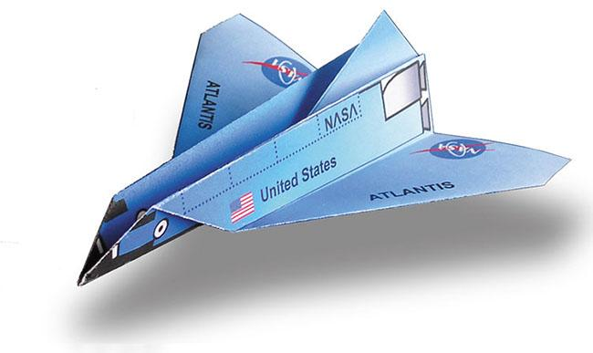
So, some example instructions
If you have a piece of paper handy and are feeling antsy, follow the link below to instructions for folding paper shuttle. You are free to fold the paper shuttle while I continue my presentation (if you are comfortable doing so).
CLICK FOR INSTRUCTIONS

Slide 7
Distance Education
ID
(as an astrological system)

Slide 8
Core Priorities -
Managing Course Standards
Engagement
Clarity
Accessibility
Alignment
Experientiality

Slide 9
Examples of what we do in courses
COMM 101
Writing for Environmental Professionals
Students create talking points, instagrams, tweets, video testimonials, etc., assembled as a marketing manual to be deployed as part of a larger environmentalist campaign.
MBAQ 203
Global Diversity of Freshwater and Marine Resources used in Sustainable Harvest
Students create and maintain a world atlas of aquaculture using a wiki that can be useful to people outside of Unity College.
UESP 605
Sustainable Design: Creating Sustainable Buildings
Students evaluate the sustainability of an existing structure and create a plan for improving the sustainability of that structure.

Slide 10
Orbiting Priorities - Defining our Standards
Course standards
How long should videos be?
How many points should discussions be worth?
What qualifies as experiential?
How hard is too hard?
Do students need to know this?
Course Consistency
Where can courses look/operate the same?
What tools can we use to cut down on redundancy?
Fixing errors as they arise (in live and/or template)

Slide 11
Examples of defined standards in courses.
Videos
Standards for length, load and focus of instructor lectures:
No more than 10 minute chunks.
No more than 30 minutes per week.
Faces where possible.
Breadth and synthesis, rather than going over assigned material.
Modules
Standard course structure:
Modules defined by week
Initial posts for discussions due Wednesday; everything else due Sunday
Blueprinting
All sections of a particular course link back to one blueprint.
Content isn’t changeable from within the sections themselves
Changes to the blueprint can be pushed out to all of the sections simultaneously, ensuring standards.

Slide 12
System/Department Priorities - Tools and Processes
Project Management
Stakeholder Engagement
Roles and responsibilities
Dashboards
Professional Development
Training
Process refinement
Interfacing

Slide 13
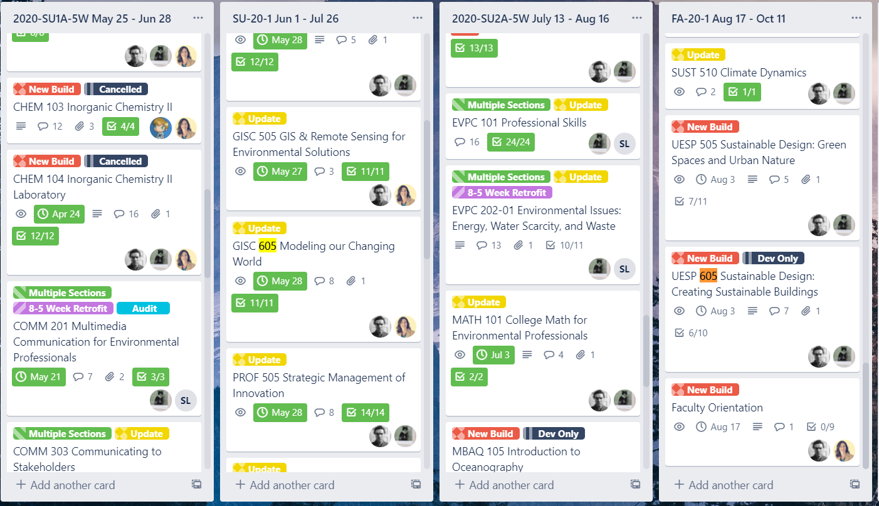
A look at a tool for our processes.

Slide 14
Did anyone fold the paper shuttle?
Business
Students who completed their paper shuttle successfully are able to:
Construct basic structures by folding paper.
Is this an accurate description of what you have shown you are capable of?
Is this what we want you to be capable of? Is this a “meaningful” or “authentic” or “experiential” activity?
Rise
Risk
Leader
Economy
Idea
Profit
Finance

Slide 15
Thanks!!
Any questions?
You can find us at:
cmalmberg@unity.edu

