Slide 1


State of the college Part 1
President Melik Peter Khoury

Slide 2


Mission
State of the college
January 2019
Through the framework of sustainability science, Unity College provides a liberal arts education that emphasizes the environment and natural resources. Through experiential and collaborative learning, our graduates emerge as responsible citizens, environmental stewards, and visionary leaders.

Slide 3







Making headlines in 2018
“Unity College Carves Out Online Niche: A small environmental college in Maine created a suite of specialized online programs with help from faculty and staff enthusiasts.”
“The number of students going to college and university has been falling for the better part of a decade … Fewer students means less money for colleges, so many are getting creative …”
“For Unity College, historic hunting lodge is a perfect fit with mission”
“The number of students going to college and university has been falling for the better part of a decade … Fewer students means less money for colleges, so many are getting creative …”
“Over the years, Unity College has expanded into several different areas … [and] the school celebrated once again as it expanded into the Moose River Valley Region.”
“Jeff Corwin, an Emmy award winner, told about 100 students receiving degrees that they can be part of the solution to ‘incredible challenges with our planet.’”
“Unity College: A Leader in Sustainability Education Preparing Students with Real-World Experience”
Up Next: Erika Latty

Slide 4

Priorities for AY 18-19
State of the college
January 2019
Strategic Plan for May
Hit target auxiliary goals; recruitment and retention goals for Flagship and DE
Maximize physical assets – Including Sky Lodge
Ensure transfer-friendliness for Flagship
Implement technology investment on time
F2Y implementation & tuition reset (Fall 20 full launch)
Execute Crisis Management Scenario in October

Slide 5
ACADEMIC Progress & ASSETS
Erika Latty, Chief Academic Officer

Slide 6
Interim (5th Year) Report for the New England Commission of Higher Education (NECHE)
From 2016 through 2018, the NEASC Mid-Cycle Coordinating Ad Hoc Committee compiled information for the Interim Report.
The committee was initially co-chaired by CAO Scott and then co-chaired by CAO Latty and CSSO Cunningham.
Membership included CBO Costedio, CDEO Arnett, CDIO Johnson, CADO Hutchinson, CoS Zavodny, Dean MacRae, Dean deHart, Director of Library and Information Services Russell, Professor Womersley, Associate Professor Chatfield, Secretary to the Board Melanson, Director of Institutional Effectiveness Vigezzi
Following an established timeline for deliverables, committee members worked with other staff members as necessary to assemble and write the sections of the report, including completion of the data forms.
A complete draft was submitted to NEASC for feedback prior to the final submission. The 150 page final report was submitted on August 15, 2018.

Slide 7
Interim (5th Year) Report for the New England Commission of Higher Education (NECHE)
Notified in December that NECHE accepted the interim report.
Our plans to offer online baccalaureate degrees in Environmental Studies, Environmental Criminal Justice, Wildlife Conservation, and Sustainable Business Management were accepted by the Commission.
Of note, NECHE commended the college for submission of an informative report including a thoughtful reflective essay, and commitment to our mission emphasizing sustainability science as the educational framework.
Confirmed the comprehensive evaluation for Fall 2022. In addition to information included in all self-studies, this report should emphasize success in:
  Evaluating the effectiveness of its new academic structure, including the replacement of Academic Centers with Schools, and the faculty assignment model consisting of professoriate and instructor tracks
  Evaluating the impact of its student success initiatives on enrollment and retention goals
  Achieving enrollment and retention goals in the new online programs and ensuring that multi-year funding plans for increased capacity to support expected growth in these programs
  Continue to clearly distinguish the role of the chief academic officer in the oversight of all academic programs offered by the College.

Slide 8
Ensure Transfer Friendliness for Flagship
State of the college
January 2019
Flagship academics has focused on the development of +2 programs (sometimes called degree completions) for all degree majors.
The purpose of this work is to facilitate awarding credit to students with associates degrees to ensure that they finish a Unity College baccalaureate degree within two years of enrolling in the flagship SEBU.
Flagship faculty began work on this project during the August professional development days.
SEC and SBC School Meetings continued this work through the fall, resulting in the completion of 16, draft +2 programs.
Finished drafts are being digitally prepared for next adoption steps, including review by the academic regulations committee.
The goal is to include requirements for +2 programs in the 2019-20 Unity College Catalog for the Flagship Campus.

Slide 9
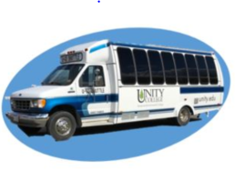
Maximize Physical Assets
Unity College Center for the Arts (UCCA)
The refurbished space contains art studios and classrooms, a new media lab, faculty offices, theater, and art gallery
11 arts and humanities classes were held in this facility in Fall 2018
Hosted numerous other events including art openings, receptions, and performances
www.unity.edu/ugo
Sky Lodge
3 flagship courses (AE 4003, PF 2123, PF 4123) stayed at the property and incorporated Sky Lodge in their curriculum during the fall. Plans for additional spring course trips are underway.
Hosting CL 2882 Snowmobile Skills as a J-term class
Planning exciting May courses including AN 2883: Archaeological Field Methods, BI 2111: Themes in Fisheries and Aquaculture: Beginning and Intermediate Fly-Fishing, and HU 2022: Literature of Fly-Fishing
Portland
Building use remains in planning stages. Anyone with ideas to share should send them to Erika Latty
McKay Farm and Research Station
Served as research station for 6 Fall flagship courses (BI 4703, SA 1003, SA 2113, IC 3413, GL 3044, and PS 2023)
Preparing to support 4 Flagship courses for Spring
Up Next: Jim Kauppila

Slide 10
Flagship PROJECTS
Jim Kauppila, Chief Facilities Management Officer

Slide 11
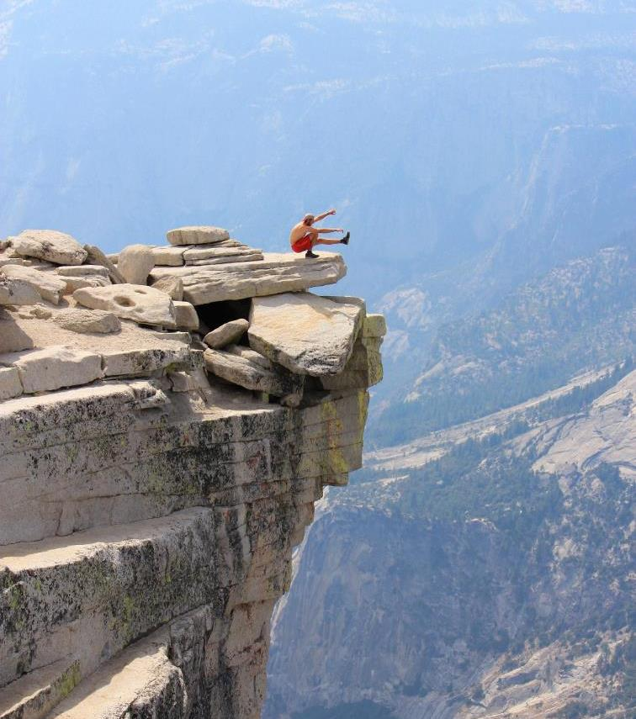
Founders Hall South &
18 Quaker Hill Road
State of the college
January 2019
Space Use Ad-Hoc Committee
Committee charge: recommend the best use of these spaces using the following criteria:
  Flagship student facing academic and or student support service needs
  Auxiliary needs
  College wide needs
Received 13 proposals from campus community
Obtained student input during October 2018 Community meeting

Slide 12
Founders Hall South &
18 Quaker Hill Road
State of the college
January 2019
Recommendations
18 Quaker Hill Road: Demolish and use for recreation, access to stream
FHS First Floor:
  ADA accessible “one stop shop” for student services:
    Registrar
    Financial Aid
    Student Accounts
    Accounts Payable/Payroll
    Career Services
    Student IDs
  Commuter Lounge
  Lab or Classroom
Next Steps
  Confirm FHS structurally sound: COMPLETE
  Ad Hoc Committee: COMMITTEE PROPOSAL DUE 1/28/19
    define scope, layout, design, cost estimates
  Identify funding: CapEx Availability
  Project completion: FALL 2019
Up Next: Jamie Cook

Slide 13
Crisis Management Planning
Jamie Cook, Director of Public Safety

Slide 14
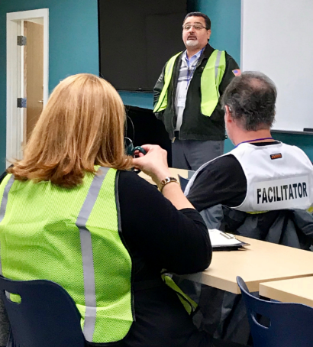
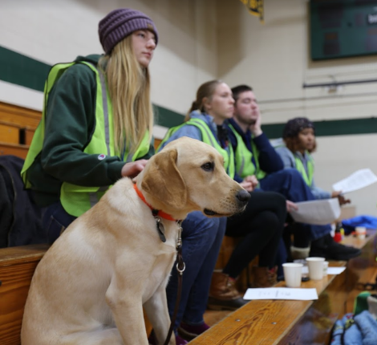
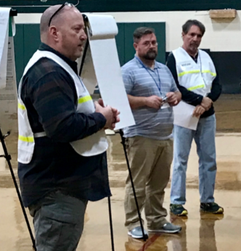
Crisis Management Planning
UC Crisis Exercise 2018: Severe Weather Simulation
Full-scale test of the UC Crisis Management Plan & Team
Exercise plan facilitated by crisis management consultants
Participation by students, staff, faculty, and county partners
Key Findings & Path Forward
UC Crisis Management Plan (CMP) is sound and solid
FEMA training needed for Crisis Management Team (CMT)
Continuous improvement of CMP, CMT, and communications
Development of a unified student emergency responder group
Relationship building with local, county, state, and federal agencies
Up Next: Brian Doore

Slide 15
THE First two Years
Brian Doore, Chief Student Success Officer

Slide 16

F2y update
Professional Development
January 2019
F2Y Implementation Team (FIT) founded November 2018
DCI Cartier Chair, CAdO Hutchinson Vice Chair
Three working groups:
  Academic Scope and Sequence (DCI Cartier)
  Living Learning Communities & Co-Curricular Learning (DOS Phinney)
  Financial Aid, Marketing, Recruitment (CAdO Hutchinson)

Slide 17
F2y update
Professional Development
January 2019
Current Activities
Development of comprehensive First and Second year experience
  Current State: development and pilot of initial Expedition for fall 2019
Site visits to innovative and promising programs
Interviews with key industry, non-profit, and NGO leaders
Identification of potential markets / regions for implementation
Up Next: Bert Audette

Slide 18
TECHNOLOGY IMPLEMENTATION
Bert Audette, Chief Information Officer

Slide 19

TECHNOLOGY INVESTMENTS
State of the College
January 2019
Business Office
Electronic requisitions and purchase orders and real-time budget reporting
  Goal: Eliminate paper-based requisitions and purchase order systems. Provide real-time budget reporting to budget managers.
  Status: Complete!
Budget Management / Forecasting
  Goal: Comprehensive budget management
  Status: Not Started
Business Office & Distance Education
Blackboard CashNet
  Goal: Consolidated online billing and payments processing, student-authorized third party payments portal, flexible payment plans, electronic refunds and 1098-T tax form delivery.
  Status: In Progress (80%)

Slide 20
TECHNOLOGY INVESTMENTS
State of the College
January 2019
Distance Education, Admissions & Operations
One simplified application for admission
    Goal: One simple application for DE and Flagship, undergraduate and graduate admissions
    Status: Complete!
Registrar, Distance Education, Admissions & Operations
TES & Transferology
    Goal: Prospective students and recruiters can easily see how courses / credits will transfer into Unity. Process is streamlined and allows for multiple levels of input and review to better engage prospective transfer students.
    Status: Complete!
Registrar & Student Success
uAchieve
    Comprehensive degree audit and academic planning tool informs students, advisors and administrators while allowing for efficient course scheduling based on student needs.
    Status: Preparing. Project kick-off scheduled for April, 2019

Slide 21
TECHNOLOGY INVESTMENTS
State of the College
January 2019
Financial Aid & Admissions
Data exchange automation and packaging process enhancement
  Goal: Data exchange between CAMS and PowerFAIDs is completely automated and mirrors data between both systems for both recruiting and financial aid use. Packaging is easier, faster, and in-line with current policy.
  Status: In Progress (25%)
Student Success & Academics
Dropout Detective / Instructor Insight
  Goal: Increase student retention by providing advisors and academic deans with tools to track progress and intervene during the semester, instead of after.
  Status: Complete!
Facilities Maintenance
eMaint
  Goal: Implement inventory controls, robust ticketing system, preventative maintenance scheduling, etc.
  Status: In Progress (30%)

Slide 22
TECHNOLOGY INVESTMENTS
State of the College
January 2019
Unity College Enterprise
PolicyTech
  Goal: Enterprise policy management and distribution solution
  Status: In Progress (25%)
DocFinity
  Goal: Electronic forms and document management solution
  Status: In Progress (40%)

Slide 23
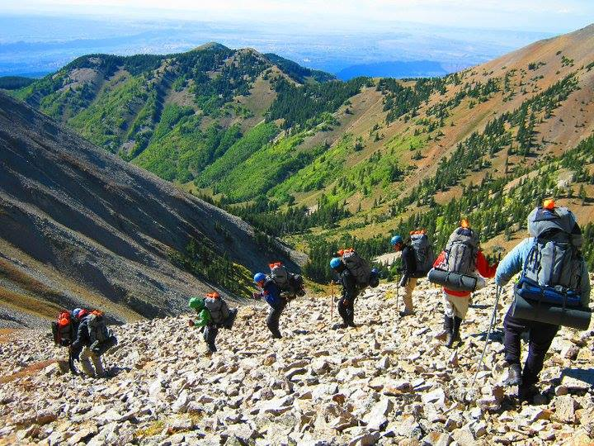
Agenda
Professional Development
January 2019
7:45 AM - 8:30 AM Welcome Reception
8:30 AM - 9:00 AM New Employee Introductions
9:00 AM - 10:00 AM State of the College – Part I
10:00 AM - 10:15 AM Break
10:15 AM - 11:45 AM State of the College – Part II
11:45 AM - 12:45 PM Lunch at Wyman Commons
12:45 PM - 1:00 PM Transition to Student Activities Building
1:00 PM - 1:30 PM Session 1
1:45 PM - 2:15 PM Session 2
2:30 PM - 3:00 PM Session 3
3:15 PM - 3:45 PM Session 4

Slide 24
Agenda
Professional Development
January 2019
7:45 AM - 8:30 AM Welcome Reception
8:30 AM - 9:00 AM New Employee Introductions
9:00 AM - 10:00 AM State of the College – Part I
10:00 AM - 10:15 AM Break
10:15 AM - 11:45 AM State of the College – Part II
11:45 AM - 12:45 PM Lunch at Wyman Commons
12:45 PM - 1:00 PM Transition to Student Activities Building
1:00 PM - 1:30 PM Session 1
1:45 PM - 2:15 PM Session 2
2:30 PM - 3:00 PM Session 3
3:15 PM - 3:45 PM Session 4

Slide 25
STATE of the College part ii

Slide 26
MID-YEAR Budget REVIEW
Holli Costedio, Chief Business Officer

Slide 27
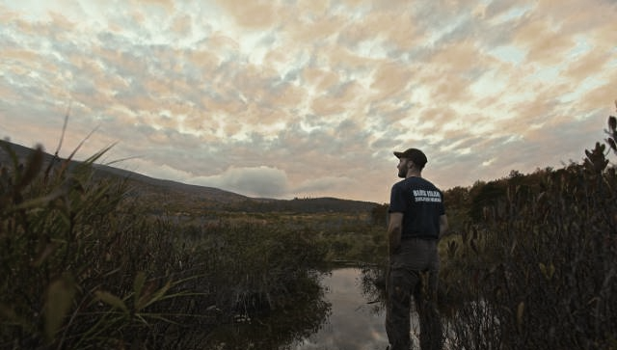
Mid-Year Review Flagship
Total Revenues:
    Mid-Year: Budget $10.9M (YTD $10.3M*)
      Net Tuition: Budget $6.3M (YTD $6.3M*)
      Gifts & Federal Grants (Aid): Budget $1.2M (YTD $890k*)
      Auxiliary Revenue: Budget $3.1M (YTD $2.8M*)
        Room & Board: Under budget $70k*
        Food Revenue: Under budget $100k*
        Events Revenue: Under budget $130k*
      Other Revenue: Budget $308k (YTD $330k*)
Total Expenses
    Mid-Year: Budget $9.7M (YTD $9.3M*)
      Various Operating: Under budget $230k* (timing)
      Events: Under budget $20k*
      Salaries & Benefits: Under budget $150k* (some timing, some open positions)
          *These numbers are estimates as December financials are still being finalized.

Slide 28

Mid-Year Review Distance Education
Total Revenues:
    Mid-Year: Budget $524k (YTD $482*)
      Net Tuition: Budget $483k (YTD $482k*)
      Federal Grants (Aid): Budget $42k (YTD $0*) timing
Total Expenses:
    Mid-Year: Budget $1.0M (YTD $640k*)
      Federal Grants (Aid): Under budget $42k timing
      Operating Expenses: Under budget $188k* timing
      Salaries & Benefits: Under budget $130k*
      *These numbers are estimates as December financials are still being finalized.

Slide 29
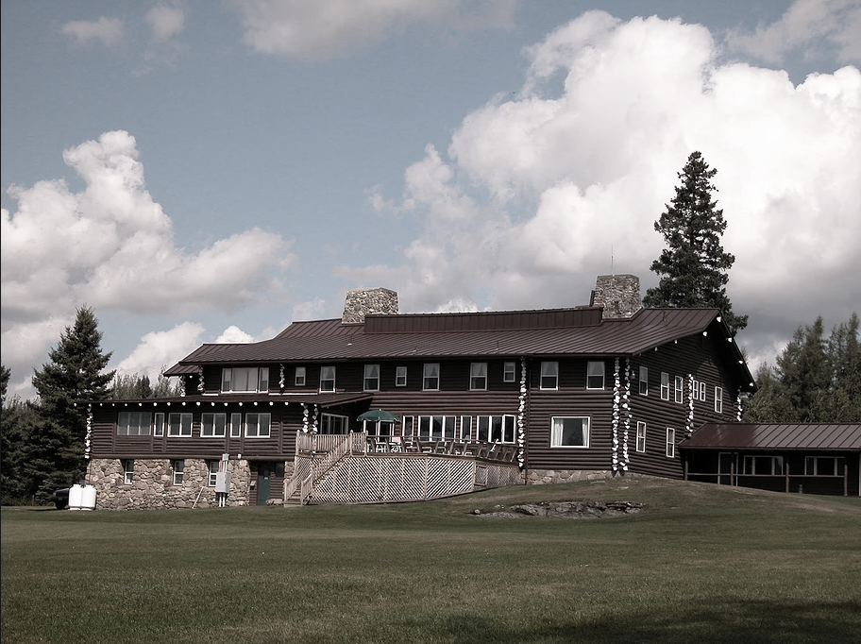
Mid-Year Review Sky Lodge
Total Revenues:
    Mid-Year: Budget $226k (YTD $77k*)
      Food Revenue: Under budget $88k
      Facility & Event Revenue: Under budget $67k
      Lodging Revenue: Ahead of budget $6k
Total Expenses:
    Mid-Year: Budget $330k (YTD $280k*)
      Cost of Food: Under budget $10k
      Other Operating Expenses: Under budget $40k
      *These numbers are estimates as December financials are still being finalized.

Slide 30
Mid-Year Review Enterprise Summary
Total Revenues: Mid-Year: Budget $11.6M (YTD $10.9M*) Total Expenses: Mid-Year: Budget $11.1M (YTD $10.2M*) Increase in Net Assets: Mid-Year: Budget $532k (YTD $640k*) $108k Ahead of Mid-Year Expected Increase to Net Assets *These numbers are estimates as December financials are still being finalized.
Up Next: Erica Hutchinson

Slide 31
Flagship
Erica Hutchinson, Chief Advancement Officer

Slide 32
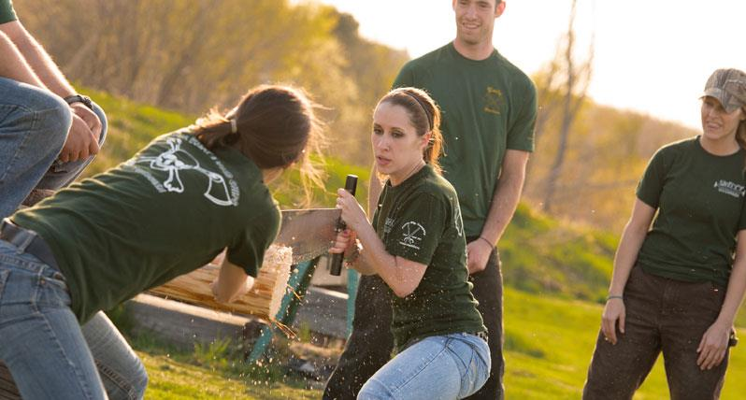




Slide 33
Up Next: Jennifer deHart

Slide 34
Sky Lodge
Jennifer deHart, Chief Sustainability Officer

Slide 35
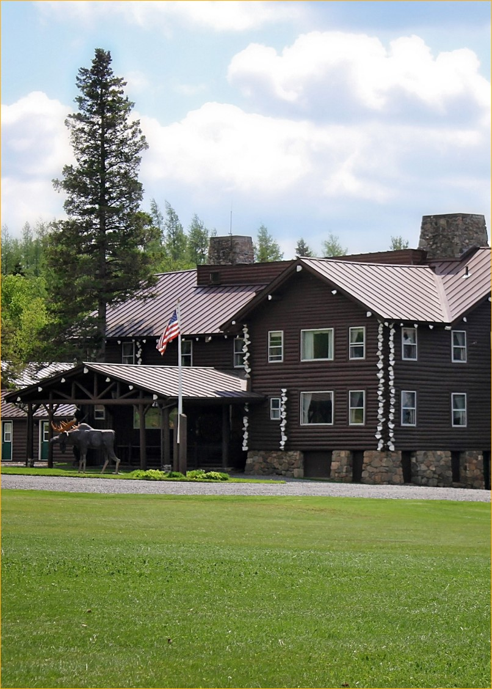
Sky Lodge
State of the College
January 2019
September Ribbon Cutting Ceremony
New web site, social media
Slightly behind YTD revenue projections; adjusting expenses accordingly
Events and reservations growing for clients, customers, community
Actively seeking academic partners
Up Next: Amy Arnett

Slide 36
Distance Education
Amy Arnett, Chief Distance Education Officer

Slide 37

Distance Education
15 Master’s program graduates in December
Four new Bachelor’s degrees:
  Wildlife Conservation
  Sustainable Business Management
  Environmental Criminal Justice
  Environmental Studies
Five Master’s programs fully launched:
  Conservation Law Enforcement
  Sustainable Natural Resource Management
  Sustainability Science
  Environmental GIScience
  Sustainable Master of Business Administration
FA-18-1 FA-18-2 SP-19-1

Slide 38

Distance Education
4 Countries
33 States
Average age: 30
Up Next: Jennifer deHart

Slide 39
Strategic Plan
Jennifer deHart, Chief Sustainability Officer

Slide 40


Strategic Plan 2025
Professional Development – January 2019

Slide 41
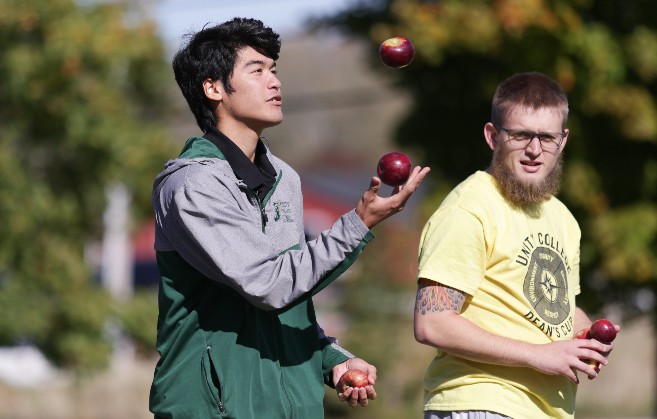
Strategic plan development
May ‘18
Retire current plan, commission new
August ‘18
Establish lens, framework, assumptions, + process w board
Fall ‘18
Develop draft plan
Spring ‘19
Develop KPIs, + multi-year budget model
May ‘19
Adopt new plan
June ‘18
Ideate w Sr. Leadership
Unity College 2025
Professional Development – January 2019

Slide 42
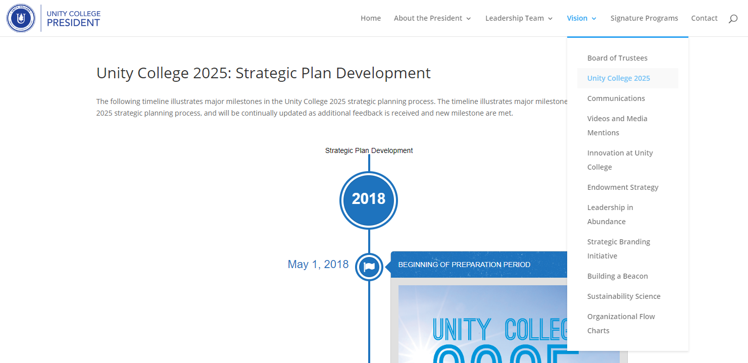
Iteration in Response to Opportunity
Responsive by design – plan-do-plan-do…
An iterative approach
Mission achievement
Responsibility and accountability
Tools for planning, implementation, and management
https://president.unity.edu/vision/strategic-plan-development/
Unity College 2025
Professional Development – January 2019

Slide 43

Status of the plan
Mission Statement – NO CHANGE
Vision Statement – FINAL DRAFT
Core Values – FINAL DRAFT
Core Value Statements – FIRST DRAFT
Guiding Principles – FINAL DRAFT
Strategy Screen – FINAL DRAFT
Process Guidelines – FINAL DRAFT
Elevator Speech – TBD
Goal Statement – ADOPTED
  Audiences – TBD
    Objectives – TBD
      Initiatives – TBD
TBD through an iterative process…
Unity College 2025
Professional Development – January 2019

Slide 44



Goal One
Goal TWO
Goal three
Establish Unity College as an ENTERPRISE APPROACH organization that serves as a new exemplar for private higher education.
Serve AUDIENCES through engagement with Unity College and its mission in response to clearly identified needs.
Share the story of Unity College through powerful STORYTELLING
and inspiring thought-leadership.

Slide 45
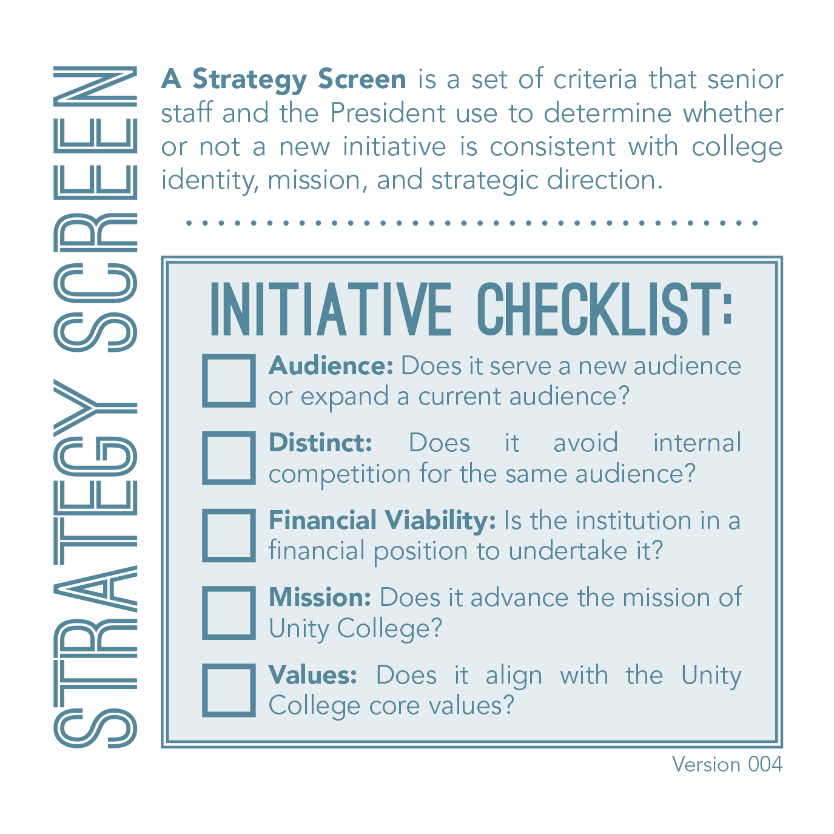

Slide 46
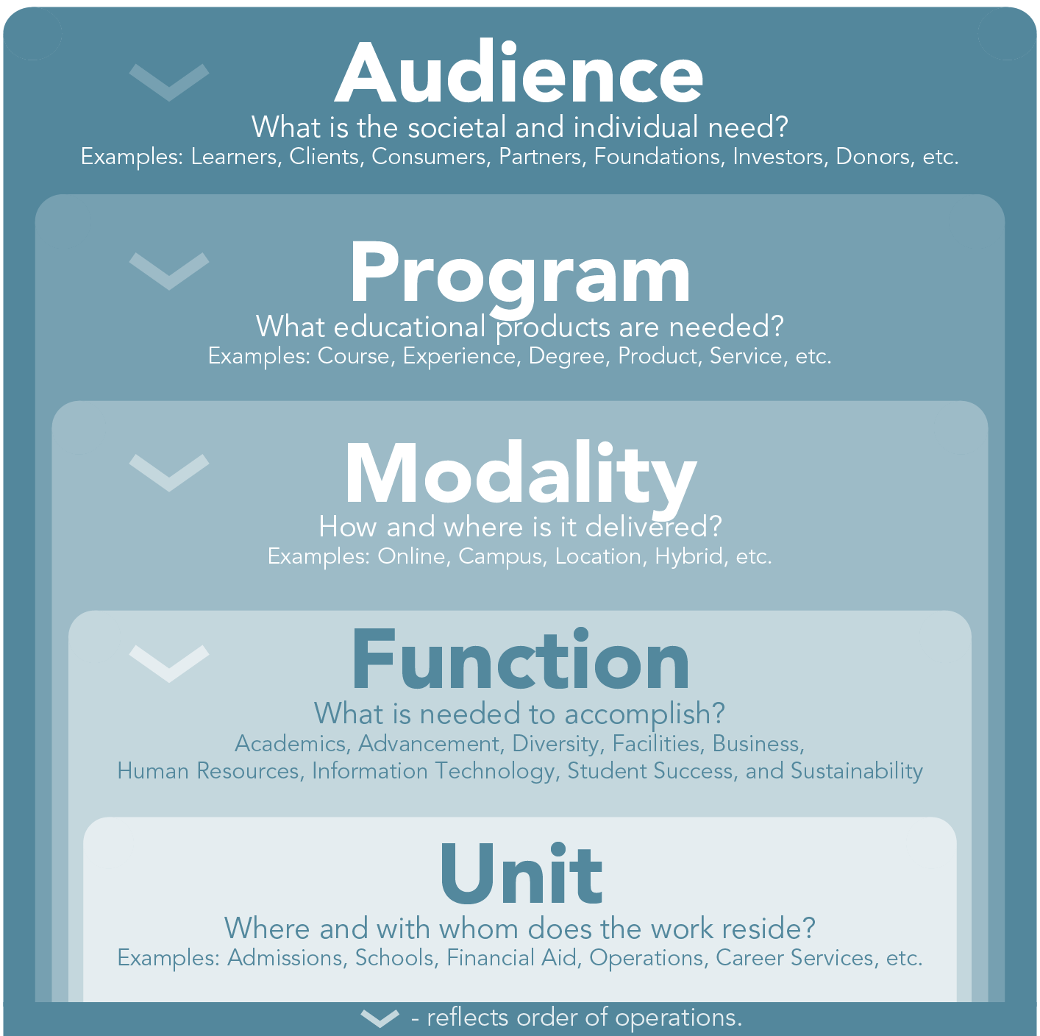
Decision making paradigm

Slide 47
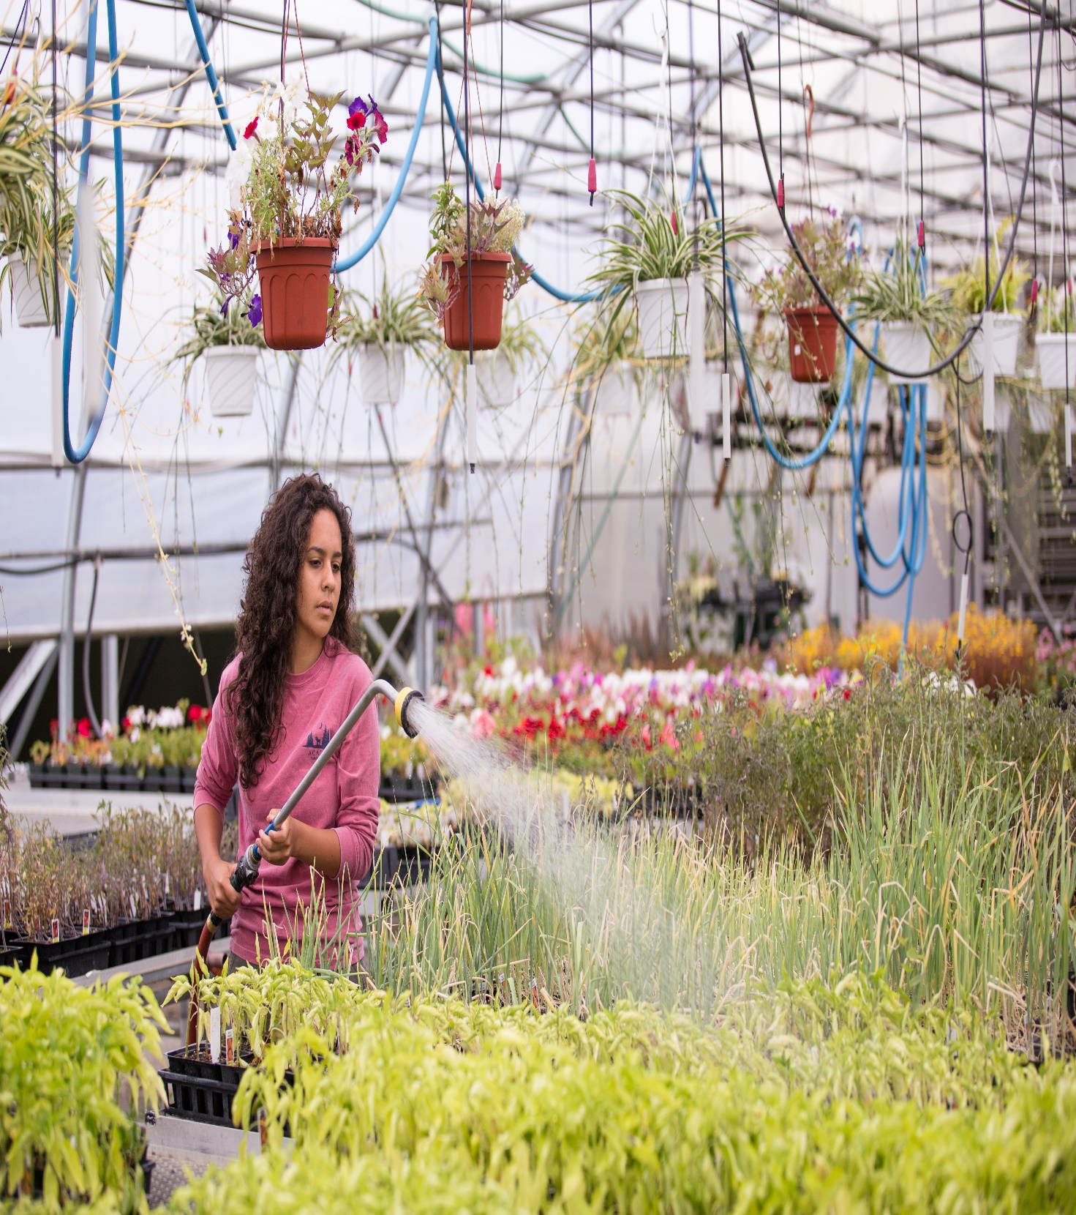
Core Values FINAL DRAFT
Respect
Integrity
Social Responsibility
Community
Resiliency
Cultural Competency
Innovation
Accountability
Unity College 2025
Professional Development – January 2019

Slide 48
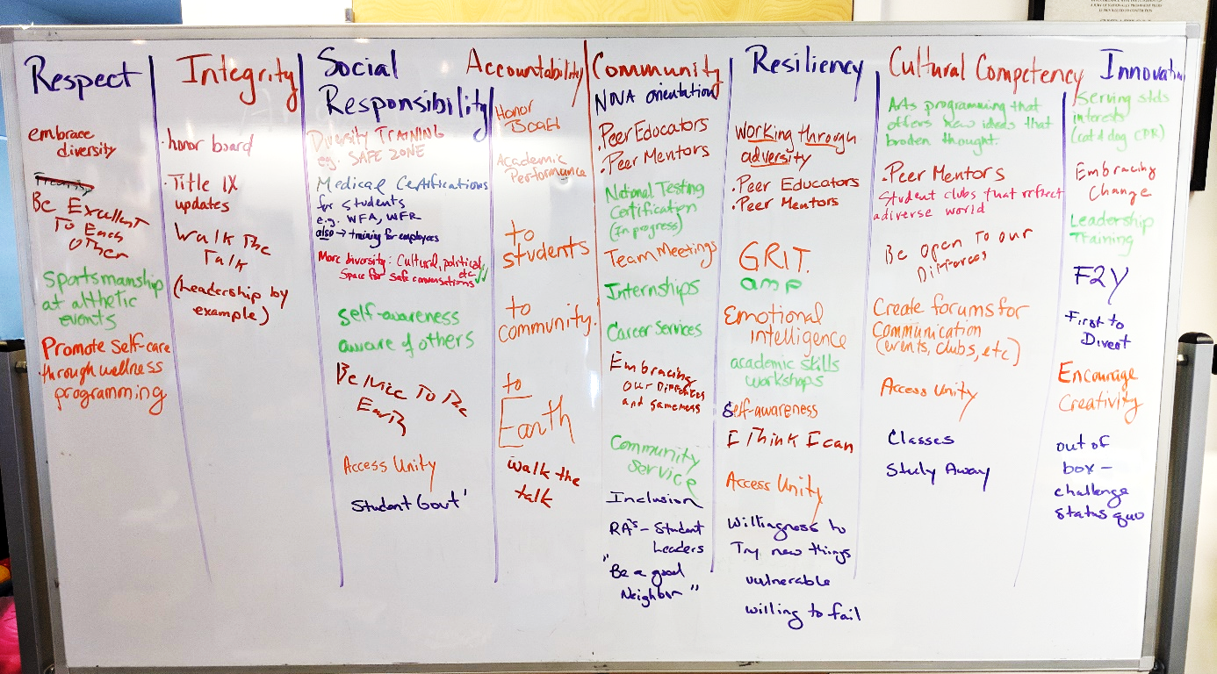
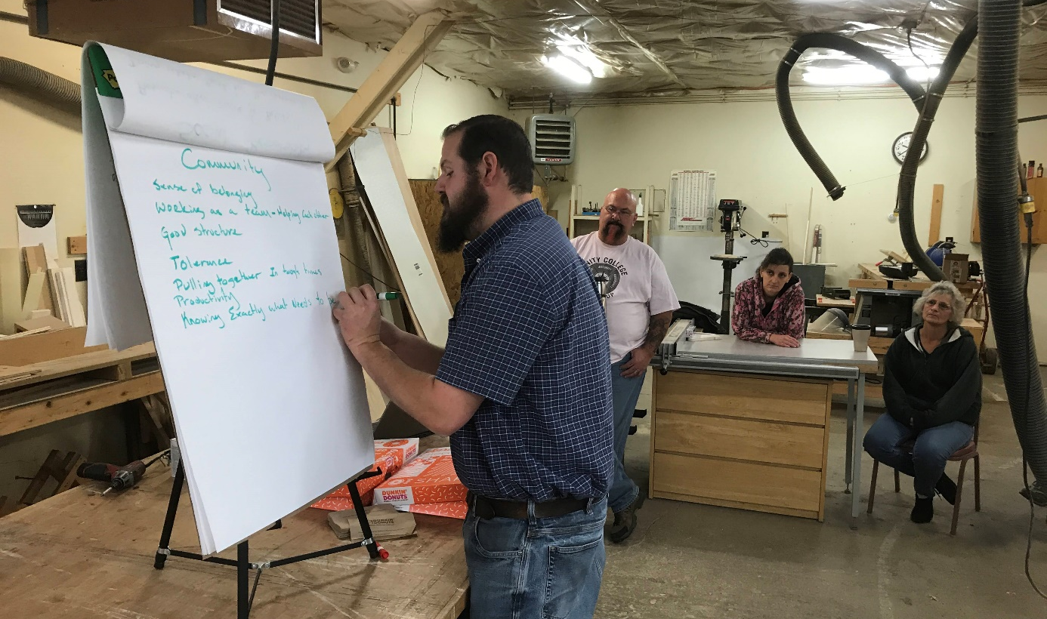
Core Value Statements FIRST Draft
Respect: We seek to understand the value of each other and the audiences we serve.
Integrity: We act ethically in alignment with our mission and values.
Unity College 2025
Professional Development – January 2019

Slide 49
Core Value Statements FIRST Draft
Social Responsibility: We are dedicated to developing citizens of the world who are committed to repairing it.
Community: Our programs reach across boundaries to connect, converge, and construct global communities.
Unity College 2025
Professional Development – January 2019

Slide 50
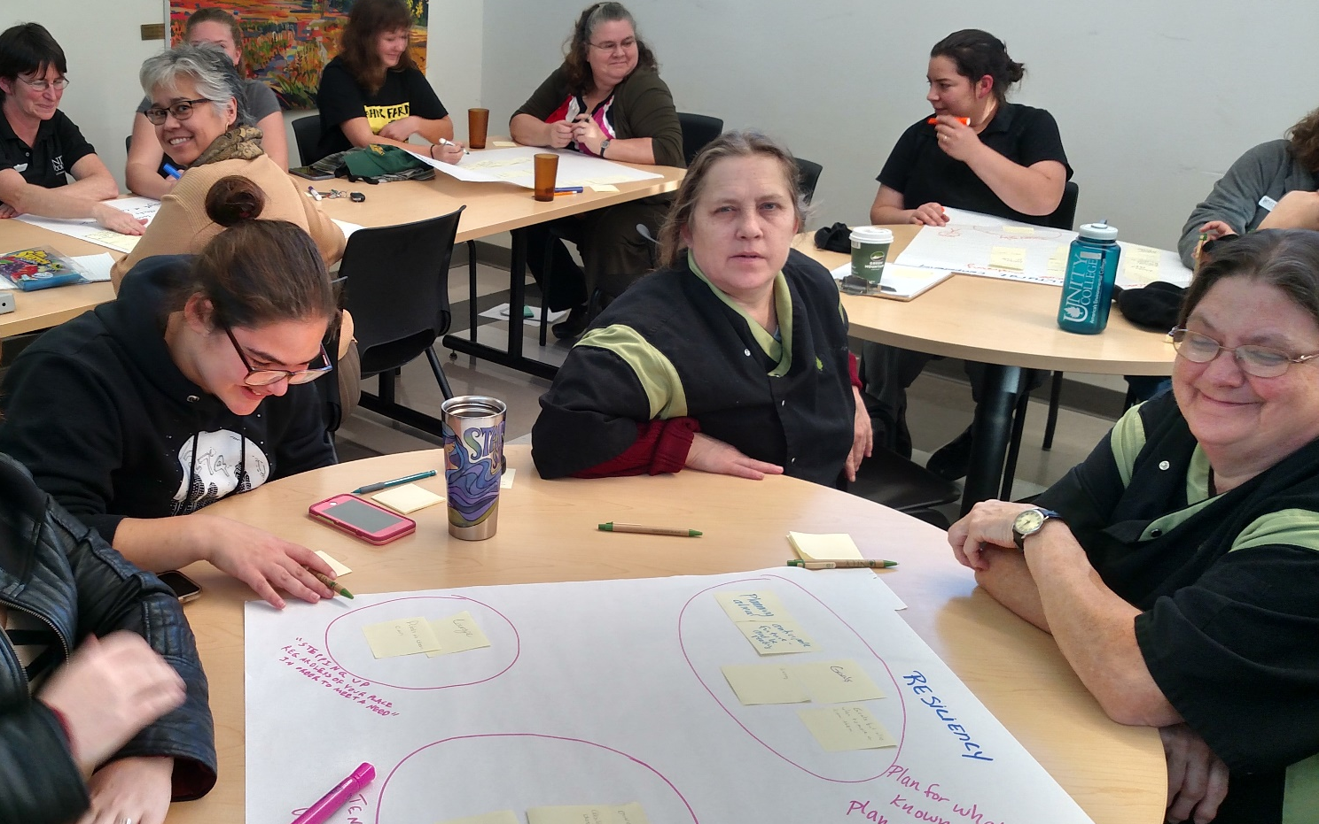
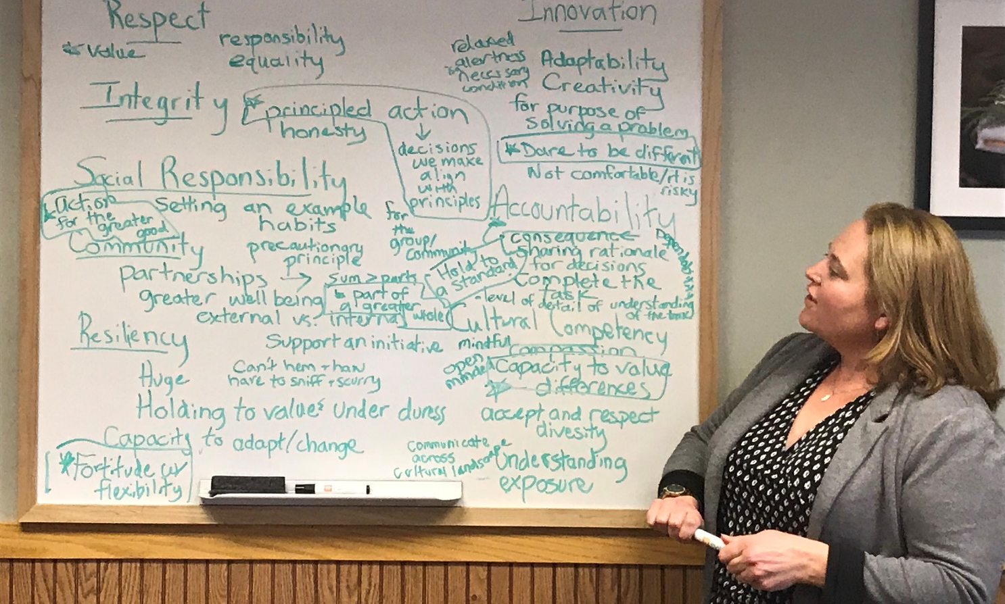
Core Value Statements FIRST Draft
Resiliency: We believe that differences and diversity enable communities to anticipate and adapt to change.
Cultural Competency: We seek to explore and develop the strengths and talents of each other and our audiences to achieve personal best.
Unity College 2025
Professional Development – January 2019

Slide 51
Core Value Statements FIRST Draft
Innovation: We promote a climate of disciplined daring and continuous improvement.
Accountability: We develop and pursue the highest standards in all that we do.
Unity College 2025
Professional Development – January 2019

Slide 52
Timeline
Professional Development
Professional Development – January 2019
January 1 – May 1, 2019: Refinement Period
1/10 Professional Development. Report on process
1/17 – 4/1 Unit meetings. Review Core Value Statements
2/19 Unity Works. Information and feedback
2/22 Board Meeting. Review final draft; adopt framework
4/2 Unity Works. Information and feedback
4/3 – 5/10 Unit meetings. Information and feedback
4/22 Community Meeting. Information and feedback
May 1 – May 29, 2019: Commitment Period
5/22 Board Meeting. Finalize Strategic Plan
5/26 Professional Development. Present Strategic Plan and implementation approach

Slide 53



Slide 54
Agenda
Professional Development
January 2019
7:45 AM - 8:30 AM Welcome Reception
8:30 AM - 9:00 AM New Employee Introductions
9:00 AM - 10:00 AM State of the College – Part I
10:00 AM - 10:15 AM Break
10:15 AM - 11:45 AM State of the College – Part II
11:45 AM - 12:45 PM Lunch at Wyman Commons
12:45 PM - 1:00 PM Transition to Student Activities Building
1:00 PM - 1:30 PM Session 1
1:45 PM - 2:15 PM Session 2
2:30 PM - 3:00 PM Session 3
3:15 PM - 3:45 PM Session 4

